Slide 1
When Hierarchy Meets 2-Hop-Labeling: Efficient Shortest Distance Queries on Road Network
Dian Ouyang¹, Lu Qin¹, Lijun Chang², Xuemin Lin³, Ying Zhang¹ and Qing Zhu⁴
¹CAI, FEIT, University of Technology Sydney, Australia
²The University of Sydney, Australia
³The University of New South Wales, Australia
⁴School of Information, Renmin University of China

Slide 2
Outline
Problem Definition
Existing Solutions
Our Solution
Performance Studies
Conclusion

Slide 3
Problem Definition

Slide 4
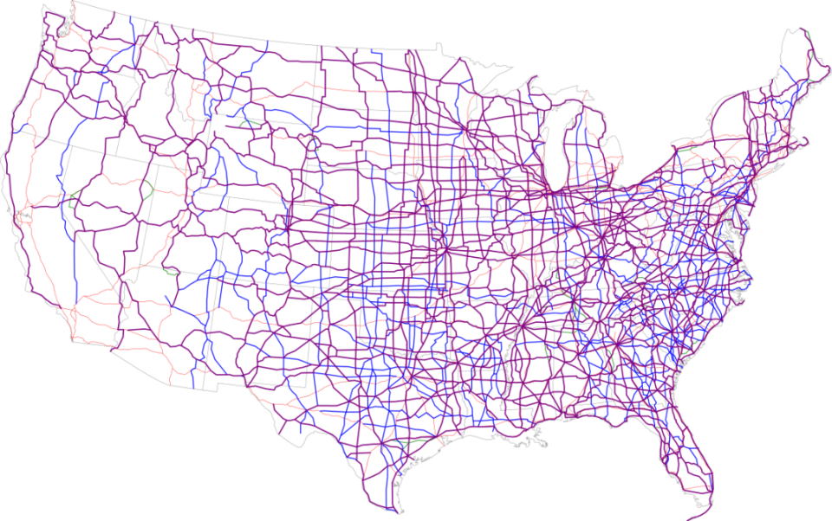
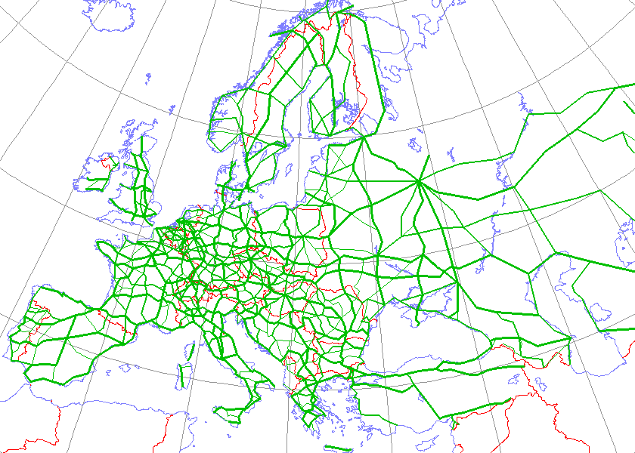
Road Networks
Road network is an undirected weighted and low-degree graph.
Notes:
文章研究的时道路网 是因为这种方式对道路网来说效果好
平面图
https://www.researchgate.net/figure/The-defined-Performance-ased-Standards-PBS-road-network-in-Australia-showing-PBS_fig4_265404087
Road network is a weighted graph. The weight of road can present distance and travel time. It is usually an approximate planar graph

Slide 5
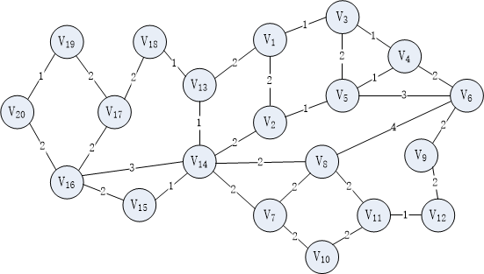
Problem Definition
Path from node s to node t, denoted by p, is a sequence of nodes connected by edges. Cost of path is sum of edge’s weight.
Example:
v = 20
e = 30
Notes:
一系列通过边连起来的点对
This is a example graph which has 8 vertices and 11 edges.
A road network is a degree-bounded connected and weighted graph G = (V,E), n = |V| and m = |E|.

Slide 6
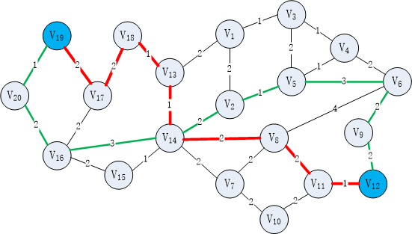
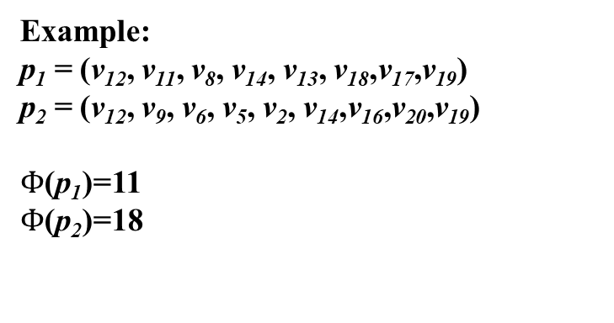
Problem Definition
A shortest distance query is defined as q = (s, t), and the answer of q is the cost of shortest path between s and t, donated as dist(s, t).
Example:
p₁ = (v₁₂, v₁₁, v₈, v₁₄, v₁₃, v₁₈,v₁₇,v₁₉)
p₂ = (v₁₂, v₉, v₆, v₅, v₂, v₁₄,v₁₆,v₂₀,v₁₉)
$Φ$(p₁)=11
$Φ$(p₂)=18

Slide 7
Application
GPS navigation
POI recommendation
Route planning services
Notes:
应用可以再加一些
地球观测卫星调度
选择一个每日拍摄序列来拍摄地球陆地带。
(earth observing satellite scheduling) select a daily shot sequence to photograph earth landbelts.

Slide 8
Existing Solution

Slide 9
Existing Solution
Hierarchy-based Solution
Hop-based Solution
CH : Contraction Hierarchies
HL: Hub-based Labeling
PHL:Pruned Highway Labeling
Notes:
可以改一下

Slide 10
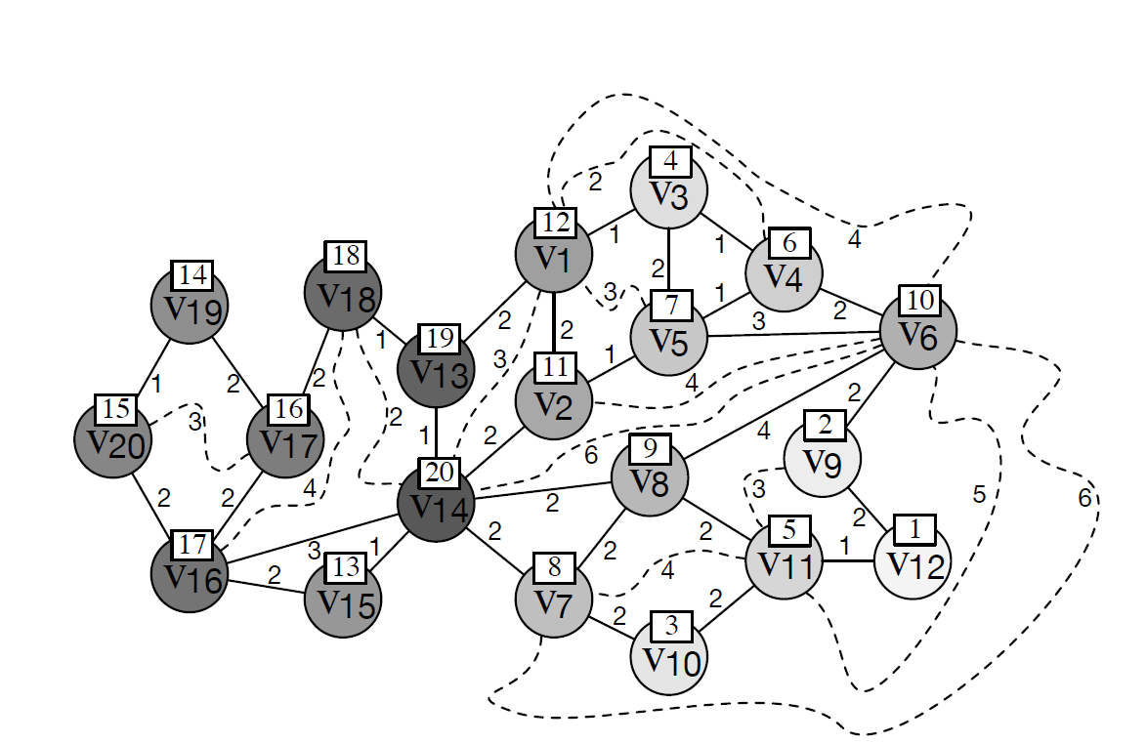
Hierarchy-based Solution
Contraction Hierarchies(CH):
CH is an indexing approach that imposes a hierarchy of all vertices in G by assigning each vertex v a rank r(v).
v12<v9<v10<v3<v11<v4<v5<v7<v8<v6<v2<v1<v15<v19<v20<
v17<v16<v18<v13<v14
Example
q = (v₁, v₆)
Notes:
颜色越深 层级越高 层级随机初始
1 确定层级
2 建立索引 从v12开始 v9 v11 的最短路径经过v12 加上曲线
3 搜索 从两端 进行 迪杰斯特拉 只能走 低层级 到 高层级的 路线

Slide 11
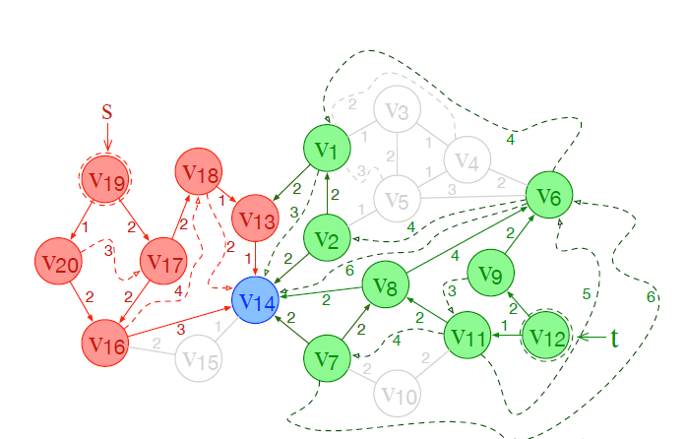
Hierarchy-based Solution
Contraction Hierarchies(CH):
CH is an indexing approach that imposes a hierarchy of all vertices in G by assigning each vertex v a rank r(v).
Example
q = (v₁₂, v₁₉)
Notes:
红色的代表从 v19 出来的搜索 绿色代表从v12出来的搜索
v14 代表 两个搜索再此相遇
标颜色的点 15个

Slide 12
Hierarchy-based Solution
Contraction Hierarchies(CH):
CH is an indexing approach that imposes a hierarchy of all vertices in G by assigning each vertex v a rank r(v).
The search space is large when query distance is long
Example
q = (v₁₂, v₁₉)
Notes:
(earth observing satellite scheduling) select a daily shot sequence to photograph earth landbelts.

Slide 13
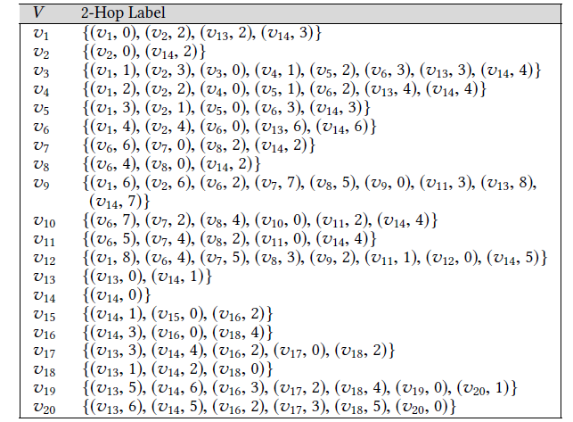
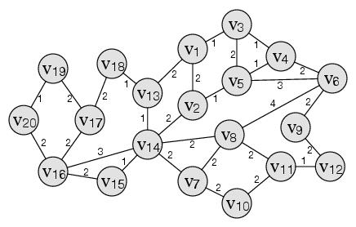
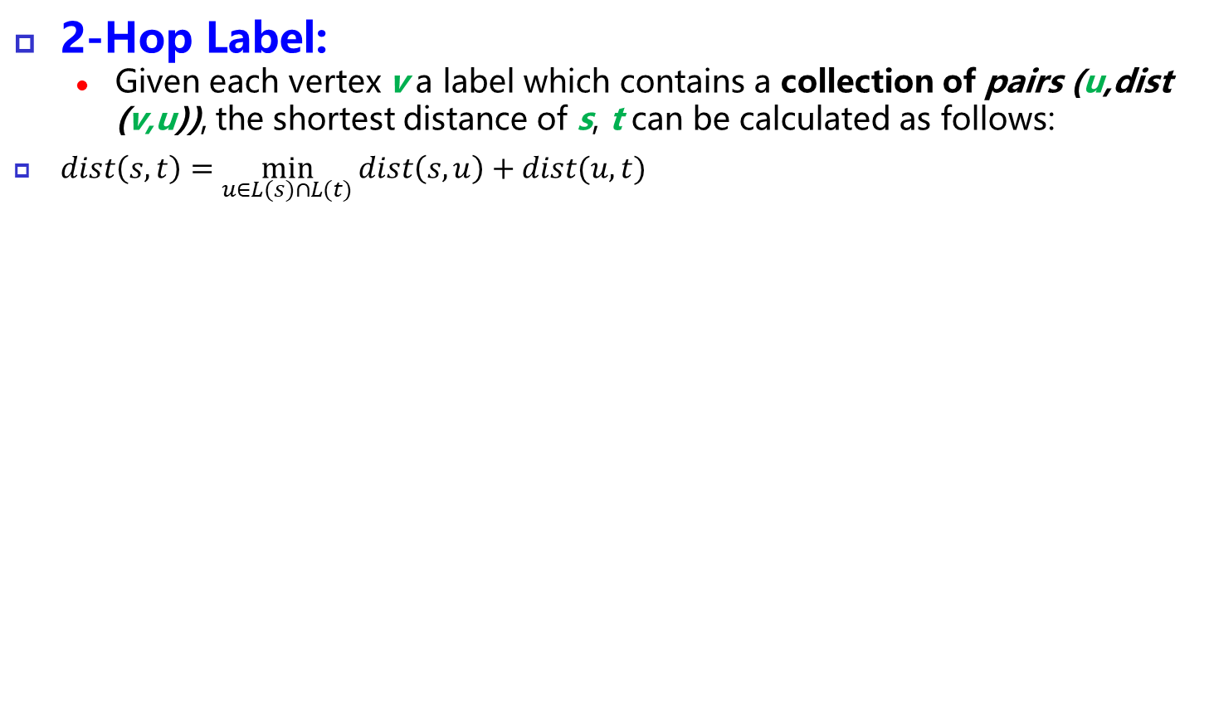
Hop-based Solution
2-Hop Label:
Given each vertex v a label which contains a collection of pairs (u,dist (v,u)), the shortest distance of s, t can be calculated as follows:
$dist\left(s,t\right)=\min_{u∈L(s)∩L(t)}{dist\left(s,u\right)+dist(u,t)}$
Notes:
要说清楚 为什么不是每个点都打标签 v5v4 v4v3 有标签了 v5v3就不用标签了
保证标签总数最小 剪枝策略

Slide 14
Hop-based Solution
2-Hop Label:
Given each vertex v a label which contains a collection of pairs (u,dist (v,u)), the shortest distance of s, t can be calculated as follows:
$dist\left(s,t\right)=\min_{u∈L(s)∩L(t)}{dist\left(s,u\right)+dist(u,t)}$
Example
q = (v₁₂, v₁₉)

Slide 15
Hop-based Solution
2-Hop Label:
Given each vertex v a label which contains a collection of pairs (u,dist (v,u)), the shortest distance of s, t can be calculated as follows:
$dist\left(s,t\right)=\min_{u∈L(s)∩L(t)}{dist\left(s,u\right)+dist(u,t)}$
Example
q = (v₁₂, v₁₉)
dist(v₁₂, v₁₉)=5+6=11
Notes:
V9 v12 需要搜索很多标签 但是在图中是邻居

Slide 16
Drawback
Hierarchy-based Solution
Hop-based Solution
The search space is too large to be accepted for long distance query.
Some pairs of label is unnecessary for distance query

Slide 17
Our Solution
Notes:
怎么赋予层级
怎么打label 使得层级可以用来选择 label

Slide 18
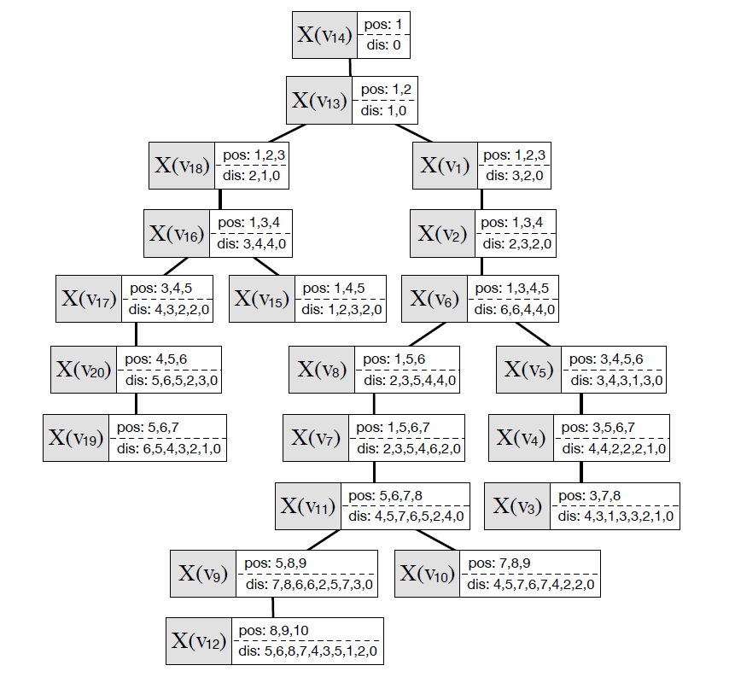
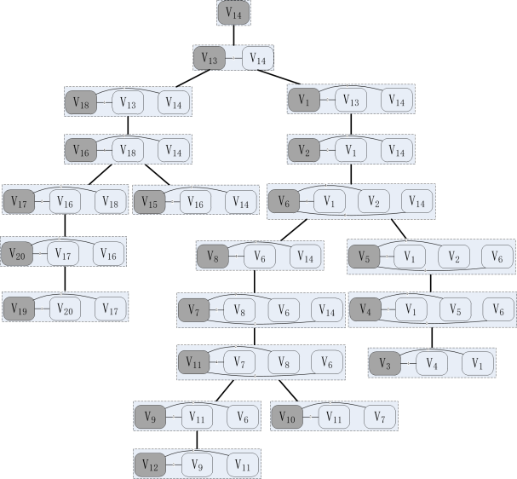
Our solution
We assign a novel 2-hop index by Tree-Decomposition.
Notes:
H2h-index
层级 和 hop based 都有优劣 结合一下
给每一个节点 赋予标签的同时 赋予层级 当我们要合并标签的时候 只需要根据层级访问一部分标签即可

Slide 19
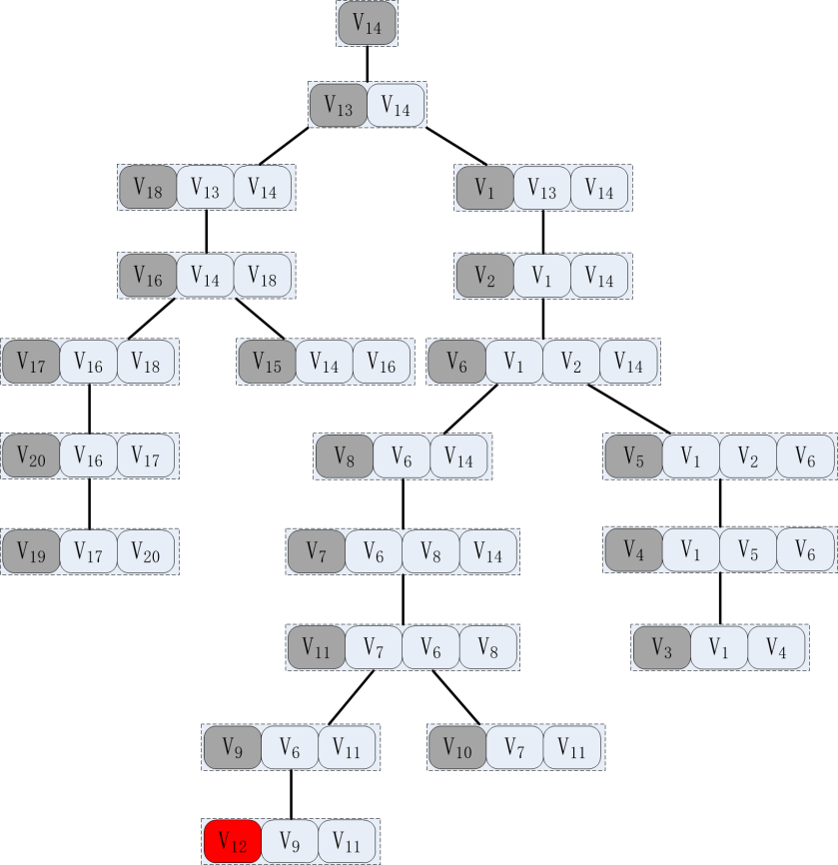
Tree Decomposition
PROPERTY 2. Given G and T_{G}, and an arbitrary node X(u) ∈ V(T_{G}), for any v ∈ X(u) \ {u}, X(v) is an ancestor of X(u) in T_{G}.
Example:
Distance Label(v₁₂)
Notes:
分解树 有一些性质 cut node
每条边都在节点中
一一对应

Slide 20
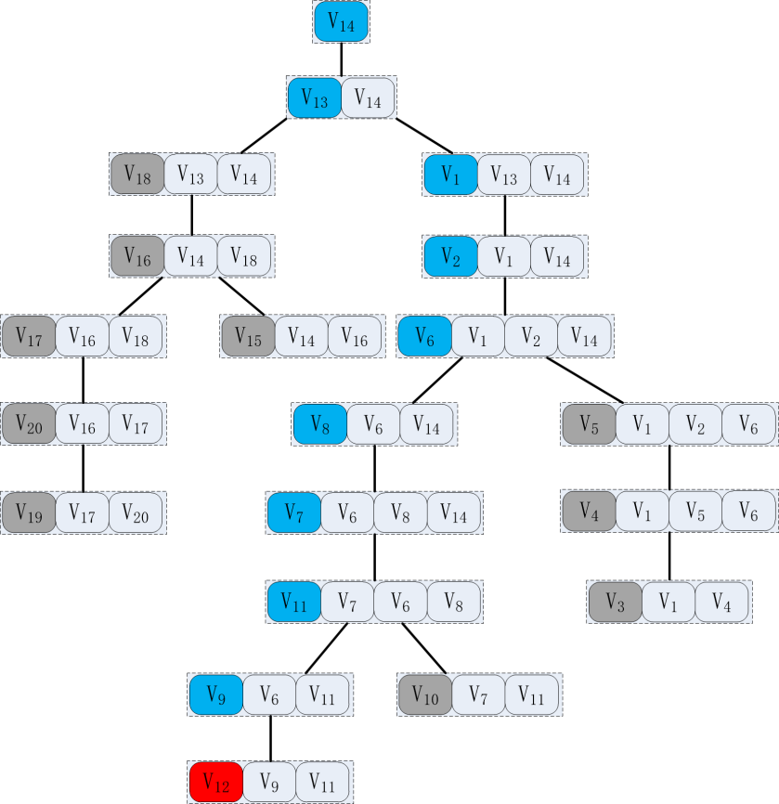
Tree Decomposition
PROPERTY 2. Given G and T_{G}, and an arbitrary node X(u) ∈ V(T_{G}), for any v ∈ X(u) \ {u}, X(v) is an ancestor of X(u) in T_{G}.
Example:
Distance Label(v₁₂) = {dist(v₁₂,v₁₄), dist(v₁₂,v₁₃), dist(v₁₂,v₁), dist(v₁₂,v₂), dist(v₁₂,v₆), dist(v₁₂,v₈), dist(v₁₂,v₇), dist(v₁₂,v₁₁) , dist(v₁₂,v₉)}

Slide 21
Tree Decomposition
PROPERTY 2. Given G and T_{G}, and an arbitrary node X(u) ∈ V(T_{G}), for any v ∈ X(u) \ {u}, X(v) is an ancestor of X(u) in T_{G}.
Label of v contains all distance from v to u which is v’s ancestor
Example:
Distance Label(v₁₂) = {dist(v₁₂,v₁₄), dist(v₁₂,v₁₃), dist(v₁₂,v₁), dist(v₁₂,v₂), dist(v₁₂,v₆), dist(v₁₂,v₈), dist(v₁₂,v₇), dist(v₁₂,v₁₁) , dist(v₁₂,v₉)}

Slide 22
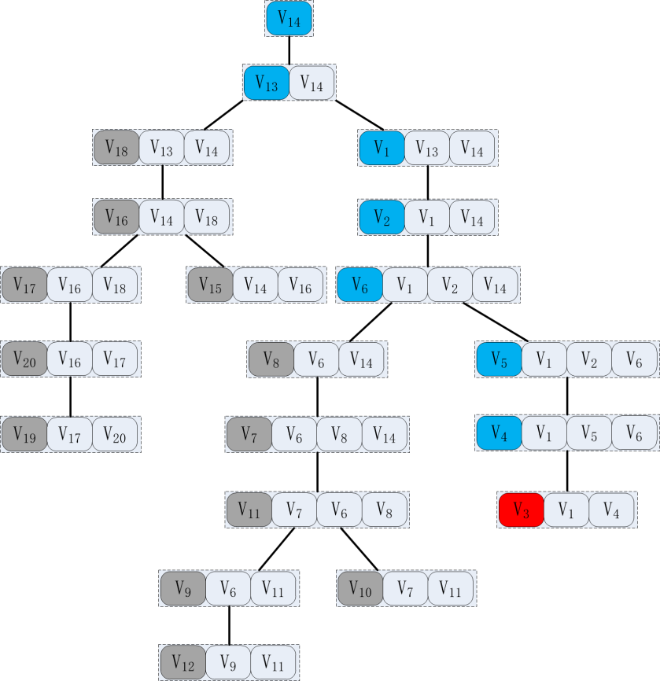
Tree Decomposition
PROPERTY 2. Given G and T_{G}, and an arbitrary node X(u) ∈ V(T_{G}), for any v ∈ X(u) \ {u}, X(v) is an ancestor of X(u) in T_{G}.
Label of v contains all distance from v to u which is v’s ancestor
Example:
Distance Label(v₃) = {dist(v₃,v₁₄), dist(v₃,v₁₃), dist(v₃,v₁), dist(v₃,v₂), dist(v₃,v₆), dist(v₃,v₅), dist(v₃,v₄)}

Slide 23
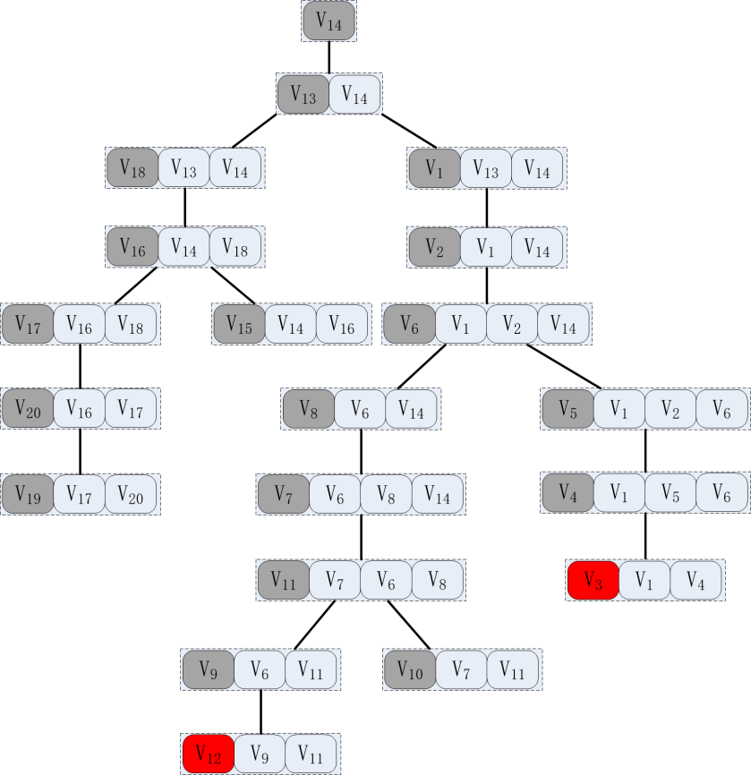
Straightforward Solution
For vertices u and v, the lowest common ancestor (LCA) X of X(u) and X(v) contains all common vertices which should be computed in distance query.
Example:
q = (v₁₂, v₃)
Notes:
LCA操作o（1） 就可以

Slide 24
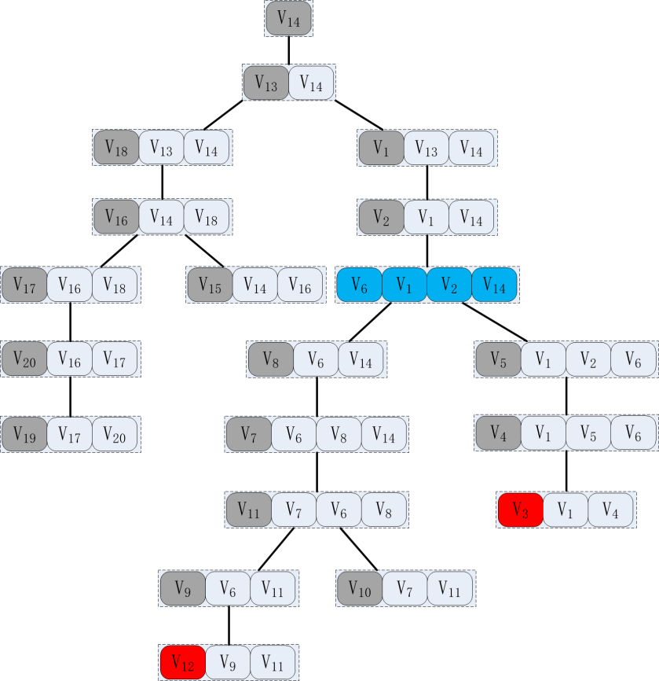
Straightforward Solution
For vertices u and v, the lowest common ancestor (LCA) X of X(u) and X(v) contains all common vertices which should be computed in distance query.
Example:
q = (v₁₂, v₃)
LCA = X(v₆)

Slide 25
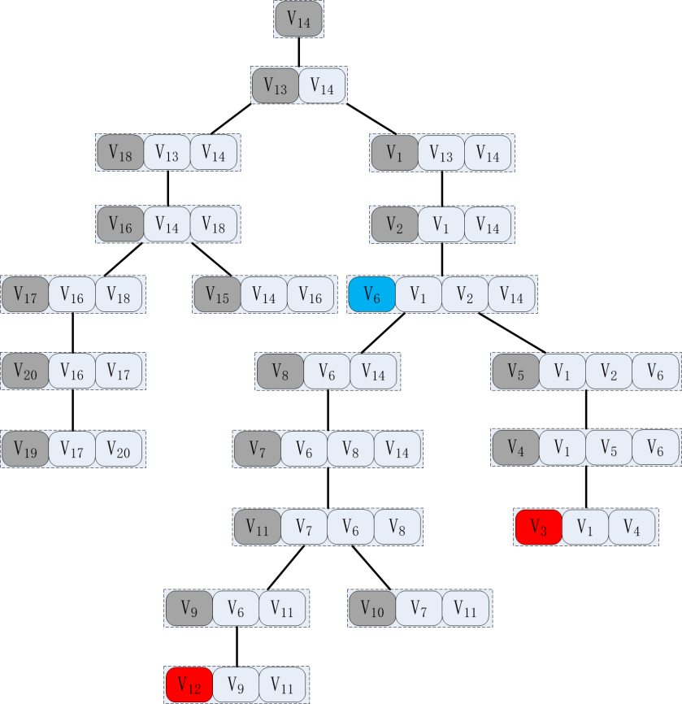
Straightforward Solution
For vertices u and v, the lowest common ancestor (LCA) X of X(u) and X(v) contains all common vertices which should be computed in distance query.
Example:
q = (v₁₂, v₃)
LCA = X(v₆)

Slide 26
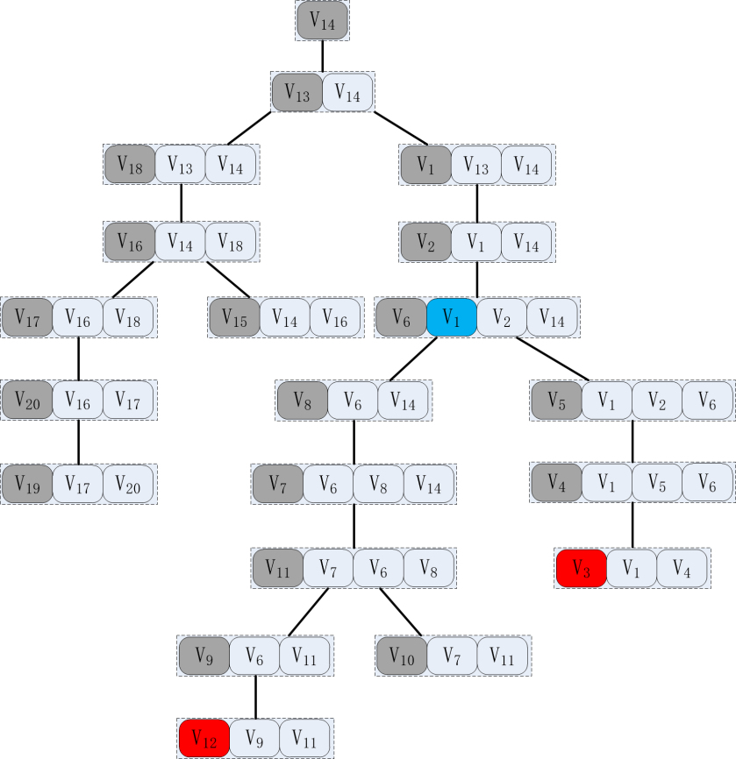
Straightforward Solution
For vertices u and v, the lowest common ancestor (LCA) X of X(u) and X(v) contains all common vertices which should be computed in distance query.
Example:
q = (v₁₂, v₃)
LCA = X(v₆)

Slide 27
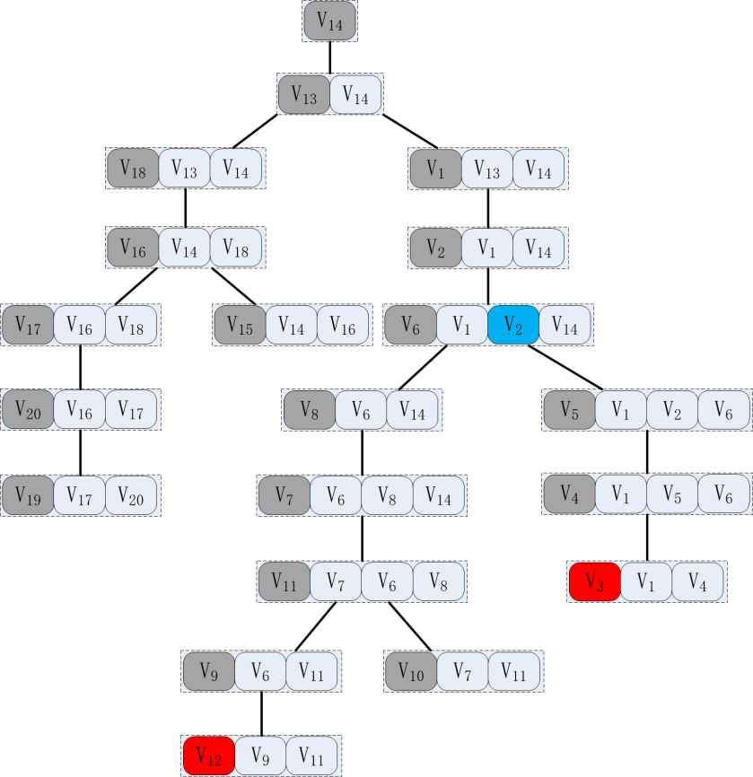
Straightforward Solution
For vertices u and v, the lowest common ancestor (LCA) X of X(u) and X(v) contains all common vertices which should be computed in distance query.
Example:
q = (v₁₂, v₃)
LCA = X(v₆)

Slide 28
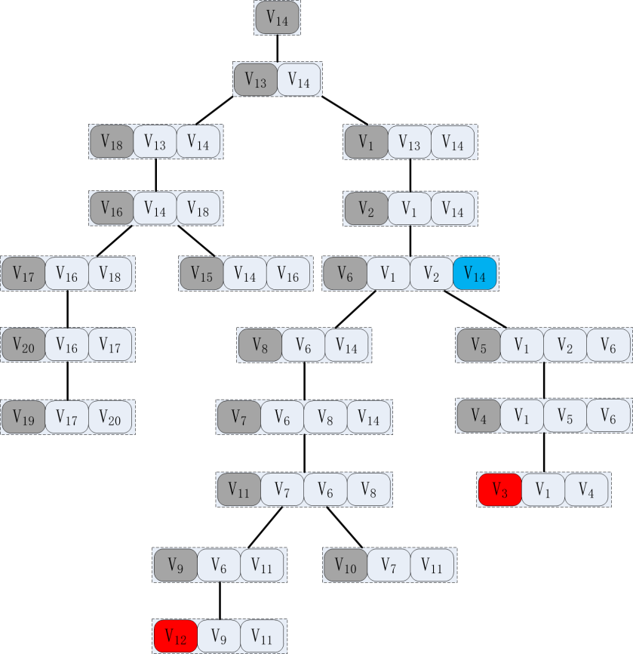
Straightforward Solution
For vertices u and v, the lowest common ancestor (LCA) X of X(u) and X(v) contains all common vertices which should be computed in distance query.
Example:
q = (v₁₂, v₃)
LCA = X(v₆)

Slide 29
Straightforward Solution
For vertices u and v, the lowest common ancestor (LCA) X of X(u) and X(v) contains all common vertices which should be computed in distance query.
Example:
q = (v₁₂, v₃)
LCA = X(v₆)
Distance Label(v₁₂) = {dist(v₁₂,v₁₄), dist(v₁₂,v₁₃), dist(v₁₂,v₁), dist(v₁₂,v₂), dist(v₁₂,v₆), dist(v₁₂,v₈), dist(v₁₂,v₇), dist(v₁₂,v₁₁) , dist(v₁₂,v₉)}
Distance Label(v₃) = {dist(v₃,v₁₄), dist(v₃,v₁₃), dist(v₃,v₁), dist(v₃,v₂), dist(v₃,v₆), dist(v₃,v₅), dist(v₃,v₄)}
Notes:
O(nhw)
建立hash表 然后找

Slide 30
Straightforward Solution
For vertices u and v, the lowest common ancestor (LCA) X of X(u) and X(v) contains all common vertices which should be computed in distance query.
Example:
q = (v₁₂, v₃)
Answer = min{dist(v₁₂,v₁₄)+dist(v₃,v₁₄), dist(v₁₂,v₁) )+dist(v₃,v₁), dist(v₁₂,v₂) )+dist(v₃,v₂), dist(v₁₂,v₆) )+dist(v₃,v₆)}
Notes:
O（nhw）

Slide 31
Hierarchical 2-Hop Index (H2H-Index)
Distance Label:
Present the distance of label
Position array:
Locate the common vertices in distance label

Slide 32
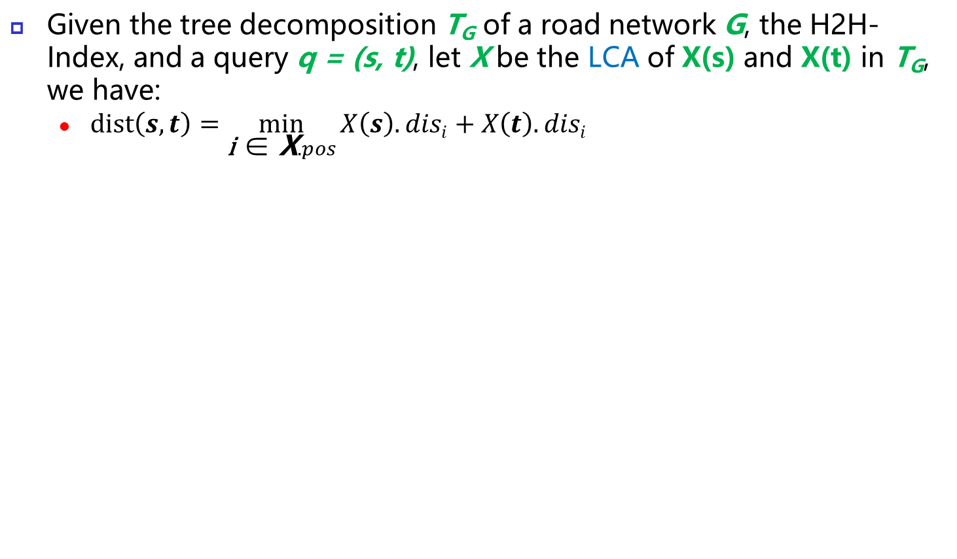
Query Processing using H2H-Index
Given the tree decomposition T_{G} of a road network G, the H2H-Index, and a query q = (s, t), let X be the LCA of X(s) and X(t) in T_{G}, we have:
$dist\left(s,t\right)=\min_{\text{i}\text{ ∈ }\text{X}.pos}{X\left(s\right).disi+X\left(t\right).disi}$
X(V₆)
pos:1, 3, 4, 5
dis: …
X(V₃)
pos: …
X(V₁₂)
pos: …
dis:4, 3, 1, 3, 3, …
dis:5, 6, 8, 7, 4, …
Notes:
根据pos 查询dis标签

Slide 33
Query Processing using H2H-Index
Given the tree decomposition T_{G} of a road network G, the H2H-Index, and a query q = (s, t), let X be the LCA of X(s) and X(t) in T_{G}, we have:
$dist\left(s,t\right)=\min_{\text{i}\text{ ∈ }\text{X}.pos}{X\left(s\right).disi+X\left(t\right).disi}$
X(V₆)
dist(v₁₂,v₃)= min(5+4,…
pos:1, 3, 4, 5
dis: …
X(V₃)
pos: …
X(V₁₂)
pos: …
dis:4, 3, 1, 3, 3, …
dis:5, 6, 8, 7, 4, …

Slide 34
Query Processing using H2H-Index
Given the tree decomposition T_{G} of a road network G, the H2H-Index, and a query q = (s, t), let X be the LCA of X(s) and X(t) in T_{G}, we have:
$dist\left(s,t\right)=\min_{\text{i}\text{ ∈ }\text{X}.pos}{X\left(s\right).disi+X\left(t\right).disi}$
X(V₆)
dist(v₁₂,v₃)= min(5+4, 8+1…
pos:1, 3, 4, 5
dis: …
X(V₃)
pos: …
X(V₁₂)
pos: …
dis:4, 3, 1, 3, 3, …
dis:5, 6, 8, 7, 4, …

Slide 35
Query Processing using H2H-Index
Given the tree decomposition T_{G} of a road network G, the H2H-Index, and a query q = (s, t), let X be the LCA of X(s) and X(t) in T_{G}, we have:
$dist\left(s,t\right)=\min_{\text{i}\text{ ∈ }\text{X}.pos}{X\left(s\right).disi+X\left(t\right).disi}$
X(V₆)
dist(v₁₂,v₃)= min(5+4, 8+1,7+3,…
pos:1, 3, 4, 5
dis: …
X(V₃)
pos: …
X(V₁₂)
pos: …
dis:4, 3, 1, 3, 3, …
dis:5, 6, 8, 7, 4, …

Slide 36
Query Processing using H2H-Index
Given the tree decomposition T_{G} of a road network G, the H2H-Index, and a query q = (s, t), let X be the LCA of X(s) and X(t) in T_{G}, we have:
$dist\left(s,t\right)=\min_{\text{i}\text{ ∈ }\text{X}.pos}{X\left(s\right).disi+X\left(t\right).disi}$
X(V₆)
dist(v₁₂,v₃)= min(5+4, 8+1,7+3,4+3)
pos:1, 3, 4, 5
dis: …
X(V₃)
pos: …
X(V₁₂)
pos: …
dis:4, 3, 1, 3, 3, …
dis:5, 6, 8, 7, 4, …

Slide 37
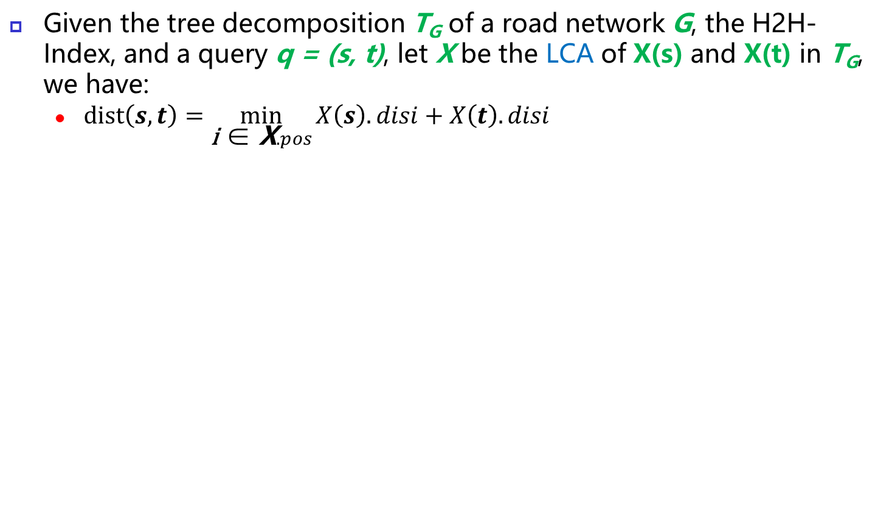
Query Processing using H2H-Index
Given the tree decomposition T_{G} of a road network G, the H2H-Index, and a query q = (s, t), let X be the LCA of X(s) and X(t) in T_{G}, we have:
$dist\left(s,t\right)=\min_{\text{i}\text{ ∈ }\text{X}.pos}{X\left(s\right).disi+X\left(t\right).disi}$
X(V₆)
dist(v₁₂,v₃)= min(5+4, 8+1,7+3,4+3)=7
pos:1, 3, 4, 5
dis: …
X(V₃)
pos: …
X(V₁₂)
pos: …
dis:4, 3, 1, 3, 3, …
dis:5, 6, 8, 7, 4, …

Slide 38
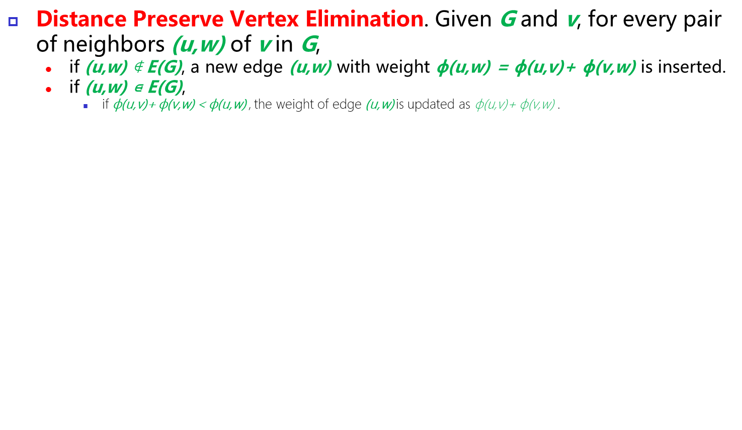
H2H-Index Construction
Distance Preserve Vertex Elimination. Given G and v, for every pair of neighbors (u,w) of v in G,
if (u,w) ∉ E(G), a new edge (u,w) with weight $\text{ϕ}$(u,w) = $\text{ϕ}$(u,v)+ $\text{ϕ}$(v,w) is inserted.
if (u,w) ⋴ E(G),
if $\text{ϕ}$(u,v)+ $\text{ϕ}$(v,w) < $\text{ϕ}$(u,w) , the weight of edge (u,w) is updated as $\text{ϕ}$(u,v)+ $\text{ϕ}$(v,w) .
Example: DP vertex Elimination of v₁
v₂
2
v₁
2
1
v₃
v₄
4

Slide 39
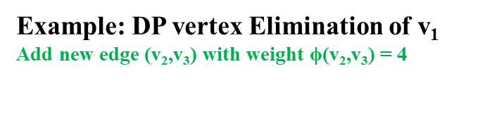
H2H-Index Construction
Distance Preserve Vertex Elimination. Given G and v, for every pair of neighbors (u,w) of v in G,
if (u,w) ∉ E(G), a new edge (u,w) with weight $\text{ϕ}$(u,w) = $\text{ϕ}$(u,v)+ $\text{ϕ}$(v,w) is inserted.
if (u,w) ⋴ E(G),
if $\text{ϕ}$(u,v)+ $\text{ϕ}$(v,w) < $\text{ϕ}$(u,w) , the weight of edge (u,w) is updated as $\text{ϕ}$(u,v)+ $\text{ϕ}$(v,w) .
Example: DP vertex Elimination of v₁
Add new edge (v₂,v₃) with weight $\text{ϕ}$(v₂,v₃) = 4
v₂
2
4
v₁
2
1
v₃
v₄
4

Slide 40
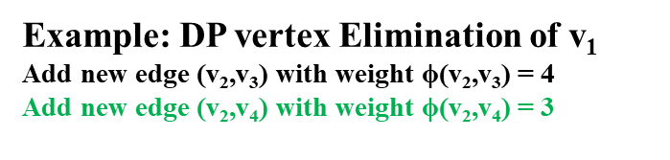
H2H-Index Construction
Distance Preserve Vertex Elimination. Given G and v, for every pair of neighbors (u,w) of v in G,
if (u,w) ∉ E(G), a new edge (u,w) with weight $\text{ϕ}$(u,w) = $\text{ϕ}$(u,v)+ $\text{ϕ}$(v,w) is inserted.
if (u,w) ⋴ E(G),
if $\text{ϕ}$(u,v)+ $\text{ϕ}$(v,w) < $\text{ϕ}$(u,w) , the weight of edge (u,w) is updated as $\text{ϕ}$(u,v)+ $\text{ϕ}$(v,w) .
Example: DP vertex Elimination of v₁
Add new edge (v₂,v₃) with weight $\text{ϕ}$(v₂,v₃) = 4
Add new edge (v₂,v₄) with weight $\text{ϕ}$(v₂,v₄) = 3
v₂
2
4
3
v₁
2
1
v₃
v₄
4

Slide 41
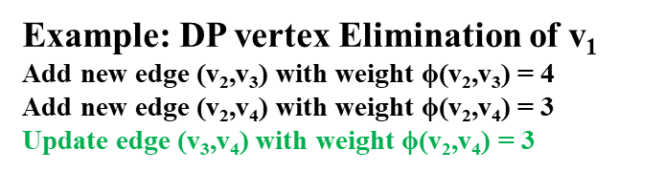
H2H-Index Construction
Distance Preserve Vertex Elimination. Given G and v, for every pair of neighbors (u,w) of v in G,
if (u,w) ∉ E(G), a new edge (u,w) with weight $\text{ϕ}$(u,w) = $\text{ϕ}$(u,v)+ $\text{ϕ}$(v,w) is inserted.
if (u,w) ⋴ E(G),
if $\text{ϕ}$(u,v)+ $\text{ϕ}$(v,w) < $\text{ϕ}$(u,w) , the weight of edge (u,w) is updated as $\text{ϕ}$(u,v)+ $\text{ϕ}$(v,w) .
Example: DP vertex Elimination of v₁
Add new edge (v₂,v₃) with weight $\text{ϕ}$(v₂,v₃) = 4
Add new edge (v₂,v₄) with weight $\text{ϕ}$(v₂,v₄) = 3
Update edge (v₃,v₄) with weight $\text{ϕ}$(v₂,v₄) = 3
v₂
2
4
3
v₁
2
1
v₃
v₄
3

Slide 42
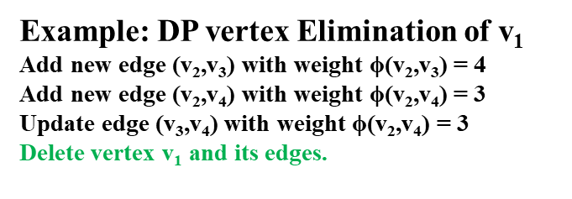
H2H-Index Construction
Distance Preserve Vertex Elimination. Given G and v, for every pair of neighbors (u,w) of v in G,
if (u,w) ∉ E(G), a new edge (u,w) with weight $\text{ϕ}$(u,w) = $\text{ϕ}$(u,v)+ $\text{ϕ}$(v,w) is inserted.
if (u,w) ⋴ E(G),
if $\text{ϕ}$(u,v)+ $\text{ϕ}$(v,w) < $\text{ϕ}$(u,w) , the weight of edge (u,w) is updated as $\text{ϕ}$(u,v)+ $\text{ϕ}$(v,w) .
Example: DP vertex Elimination of v₁
Add new edge (v₂,v₃) with weight $\text{ϕ}$(v₂,v₃) = 4
Add new edge (v₂,v₄) with weight $\text{ϕ}$(v₂,v₄) = 3
Update edge (v₃,v₄) with weight $\text{ϕ}$(v₂,v₄) = 3
Delete vertex v₁ and its edges.
v₂
4
3
v₃
v₄
3

Slide 43
H2H-Index Construction
Distance Preserve Vertex Elimination. Given G and v, for every pair of neighbors (u,w) of v in G,
if (u,w) ∉ E(G), a new edge (u,w) with weight $\text{ϕ}$(u,w) = $\text{ϕ}$(u,v)+ $\text{ϕ}$(v,w) is inserted.
if (u,w) ⋴ E(G),
if $\text{ϕ}$(u,v)+ $\text{ϕ}$(v,w) < $\text{ϕ}$(u,w) , the weight of edge (u,w) is updated as $\text{ϕ}$(u,v)+ $\text{ϕ}$(v,w) .
v₂
v₂
2
4
3
v₁
2
1
v₃
v₄
v₃
v₄
3
4
The distance is the same after eliminating v₁ between v₂ v₃ and v₄

Slide 44

H2H-Index Construction
Construct DP tree-decomposition

Slide 45
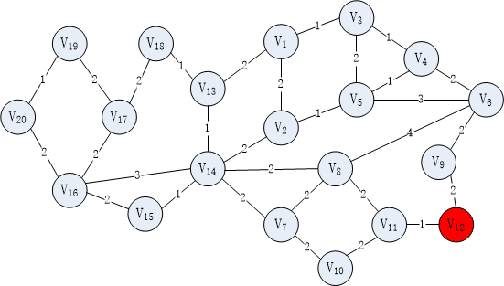
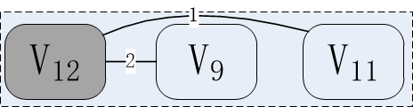
H2H-Index Construction

Slide 46
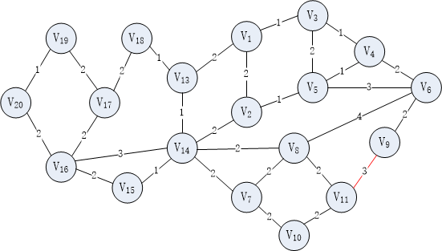
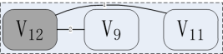
H2H-Index Construction

Slide 47
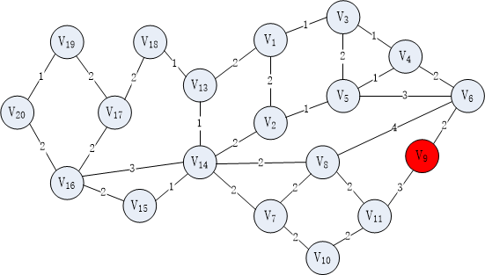

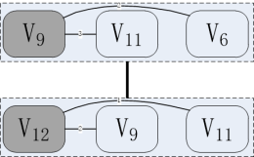
H2H-Index Construction

Slide 48
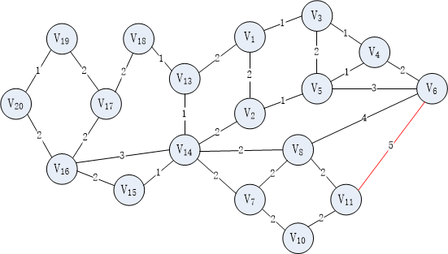
H2H-Index Construction

Slide 49
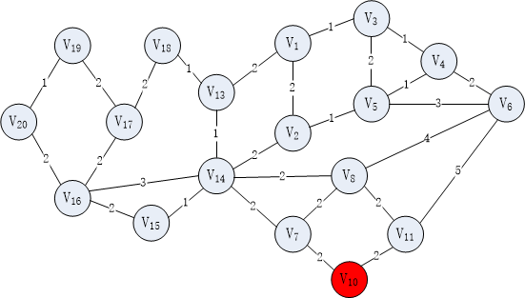
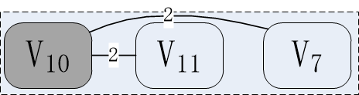
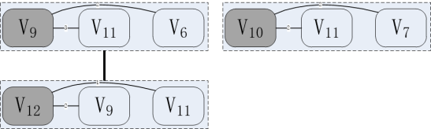
H2H-Index Construction

Slide 50
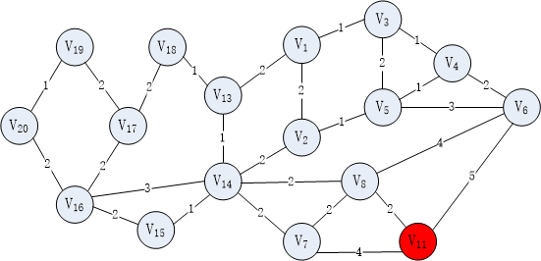
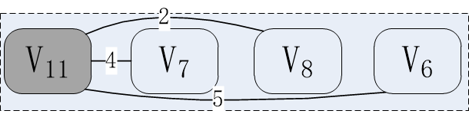
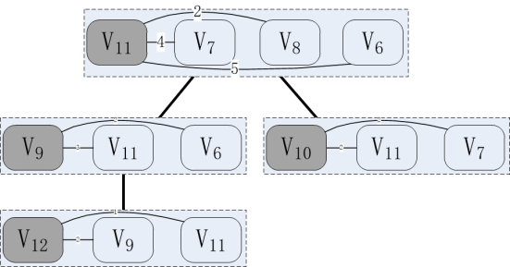
H2H-Index Construction

Slide 51
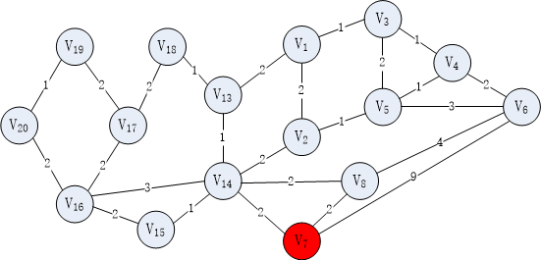

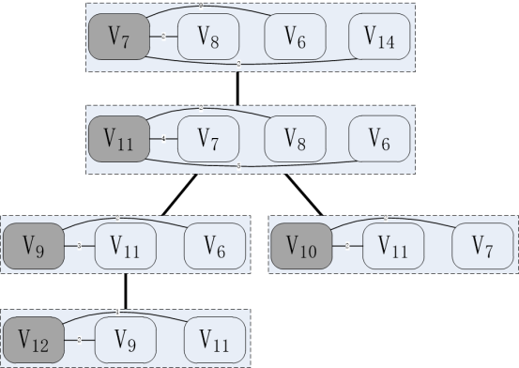
H2H-Index Construction

Slide 52
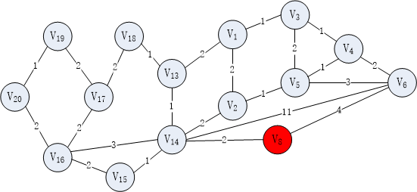
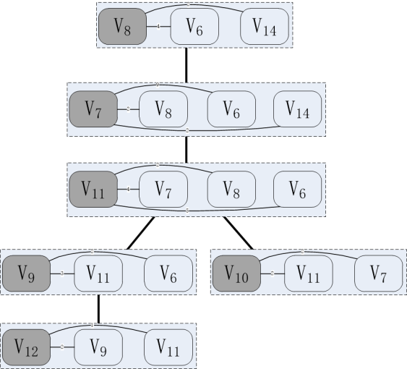
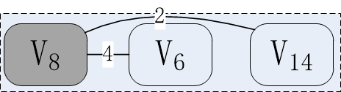
H2H-Index Construction
Notes:
根据次序来确定父子关系

Slide 53
H2H-Index Construction

Slide 54
H2H-Index Construction
Computer label by preorder traversal
Notes:
肯定是 从上到下来计算

Slide 55
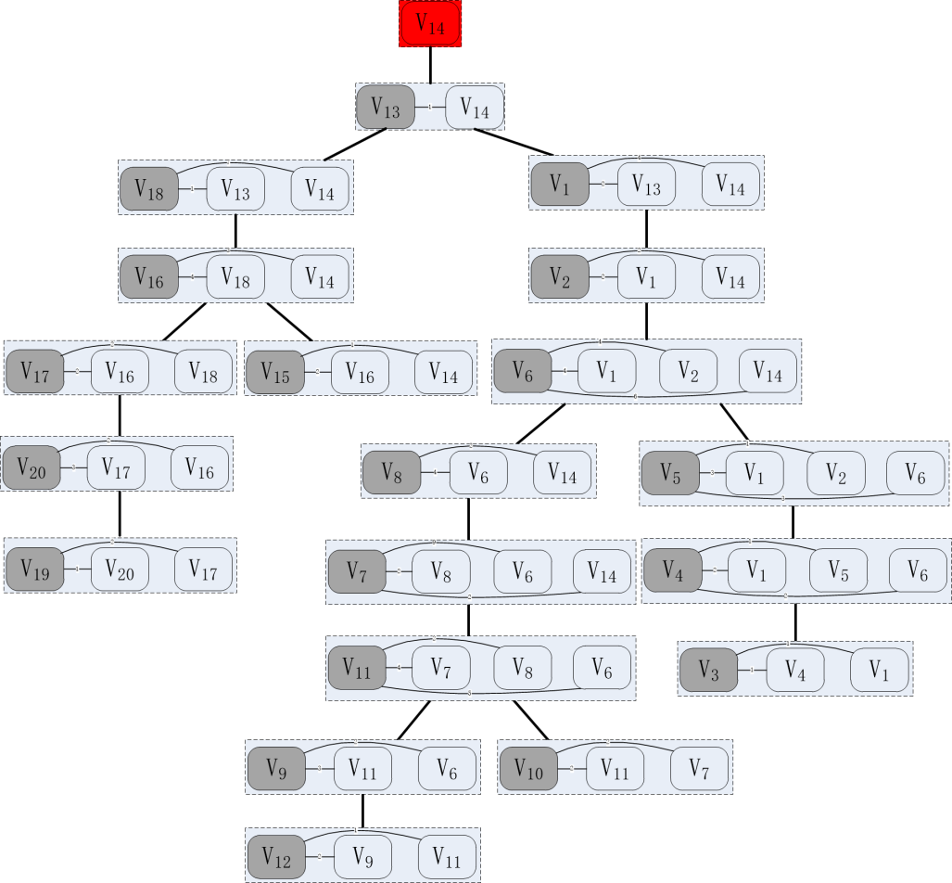
H2H-Index Construction
Computer label by preorder traversal
v₁₄
X(V₁₄)
pos: 1
dis: 0

Slide 56
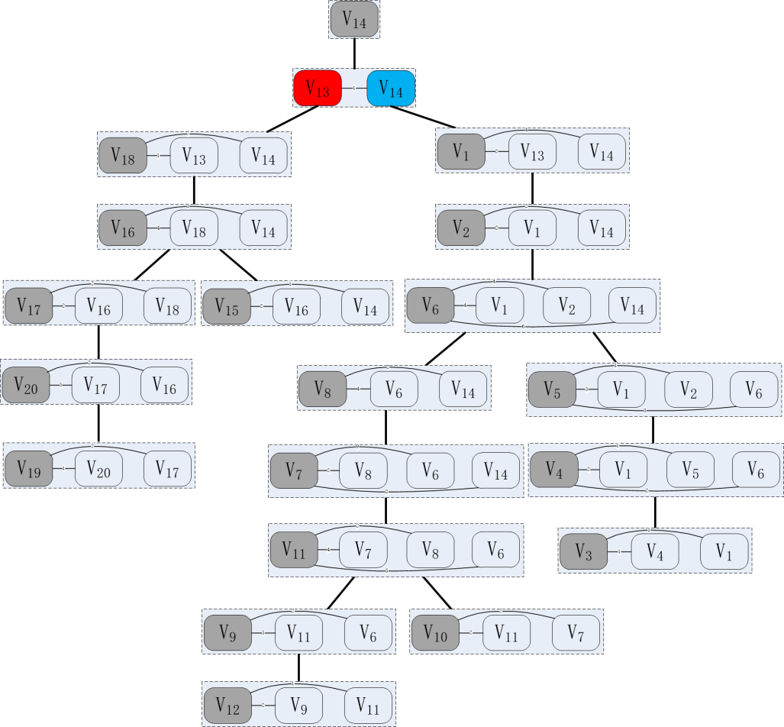
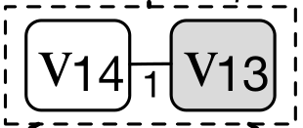
H2H-Index Construction
Computer label by preorder traversal
v₁₃
1
v₁₄
DP-TD
X(V₁₄)
pos: 1
dis: 0
X(V₁₃)
pos: 1,2
dis: 1,0
x(v13).anc={v14, v13}

Slide 57
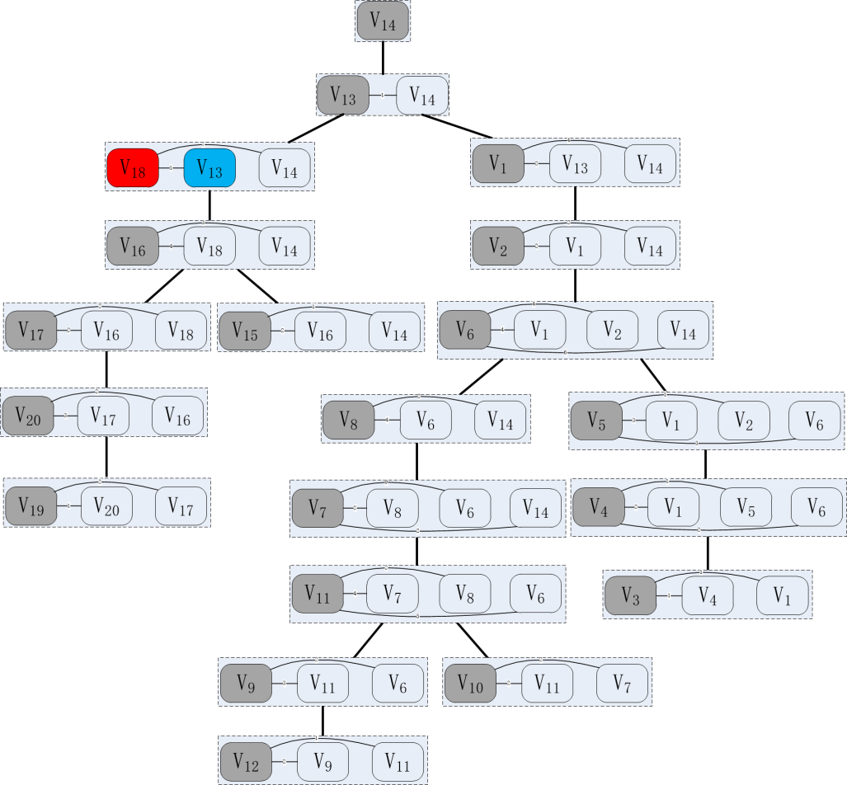

H2H-Index Construction
Computer label by preorder traversal
v₁₈
1
v₁₃
v₁₄
Existing Index
DP-TD
X(V₁₄)
pos: 1
dis: 0
X(V₁₃)
pos: 1,2
dis: 1,0
X(V₁₈)
pos: 1,2,3
dis: 2,1,0
x(v18).anc={v14, v13,v18}

Slide 58

H2H-Index Construction
Computer label by preorder traversal
v₁₈
7
v₁₄
v₁₃
Existing Index
DP-TD
X(V₁₄)
pos: 1
dis: 0
X(V₁₃)
pos: 1,2
dis: 1,0
X(V₁₈)
pos: 1,2,3
dis: 2,1,0
x(v18).anc={v14, v13,v18}

Slide 59


H2H-Index Construction
Computer label by preorder traversal
v₁₆
4
v₁₈
v₁₄
v₁₃
Existing Index
DP-TD
X(V₁₄)
pos: 1
dis: 0
X(V₁₃)
pos: 1,2
dis: 1,0
X(V₁₈)
pos: 1,2,3
dis: 2,1,0
X(V₁₆)
pos: 1,3,4
dis: 6,5,4,0
x(v16).anc={v14, v13,v18,v16}

Slide 60

H2H-Index Construction
Computer label by preorder traversal
v₁₆
3
v₁₄
v₁₃
v₁₈
Existing Index
DP-TD
X(V₁₄)
pos: 1
dis: 0
X(V₁₃)
pos: 1,2
dis: 1,0
X(V₁₈)
pos: 1,2,3
dis: 2,1,0
X(V₁₆)
pos: 1,3,4
dis: 3,4,4,0
x(v16).anc={v14, v13,v18,v16}

Slide 61
H2H-Index Construction

Slide 62
PERformance Studies

Slide 63
Performance Studies
CPU: Intel Xeon 2.8GHZ
Main Memory: 256GB
C++ GNU GCC 4.4.7
Name | Region | Vertices | Edges
NY | New York City | 264 346 | 733 846
COL | Colorado | 435 666 | 1 057 066
FLA | Florida | 1 070 376 | 2 712 798
CAL | California | 1 890 815 | 4 657 742
E-US | Eastern US | 3 598 623 | 8 778 114
W-US | Western US | 6 262 104 | 15 248 146
C-US | Central US | 14 081 816 | 34 292 496
US | United States | 23 947 347 | 58 333 344
Notes:
Indextime 40s
Trewidth 133
Avg labelsize 379

Slide 64
Performance Studies
Algorithms
CH: Contraction Hierarchy
AH: Arterial Hierarchiy
HL: Hub-based Labeling
PHL: Pruned Highway Labeling
H2H: H2H Query Processing and Index Construction

Slide 65


Experiment 1(Varying Query Distance)
Notes:
Q1 到 Q10 表示查询距离越来越长
Indextime 40s
Trewidth 133
Avg labelsize 379

Slide 66


Experiment 2(Varying Dataset Size)
Notes:
横坐标 number of vertices for each dataset

Slide 67

Experiment of Index Construction
Notes:
索引时间包括 建树时间和打标签时间

Slide 68
Conclusion
Drawback of two kinds of existing solutions
Hierarchy-based Solution: The search space is too large for long distance query.
Hop-based Solution Some of label is unnecessary for short distance query
Distance query processing using H2H Index
H2H Index Construction
DP Tree-Decomposition

Slide 69
Thank you!

Slide 70

Experiment of Index Construction

Slide 71

Tree Decomposition
Definition (Tree Decomposition) A tree decomposition of a graph G(V, E), denoted as T_{G}, is a rooted tree in which each node X ∈ V(T_{G}) is a subset of V(G) (i.e., X ⊆ V(G)) such that the following three conditions hold:
(1) ∪_{X∈V(TG)} X = V ;
(2) For every (u,v) ∈ E(G), there exists X ∈ V(T_{G}) s.t. u ∈ X and v ∈ X;
(3) For every v ∈ V(G) the set {X |v ∈ X} forms a connected subtree of T_{G}.
Hierarchical 2-Hop Index (H2H-Index)
Notes:
分解树 有一些性质 cut node
a way to map a graph to a tree to speed up solving certain computational problems in graphs.
using tree decomposition to define the vertex hierarchy, and we show that the hierarchy is effective in answering shortest distance queries in a road network.

